Slide 1
How to add the camera tool

Slide 2
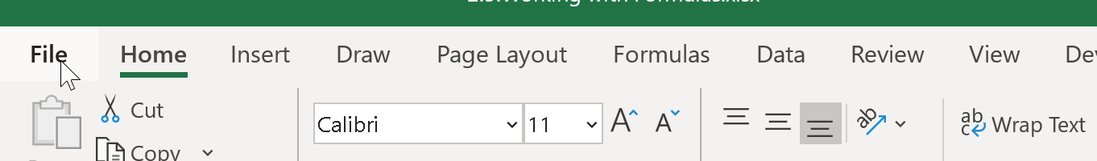
Click file in the upper left corner

Slide 3
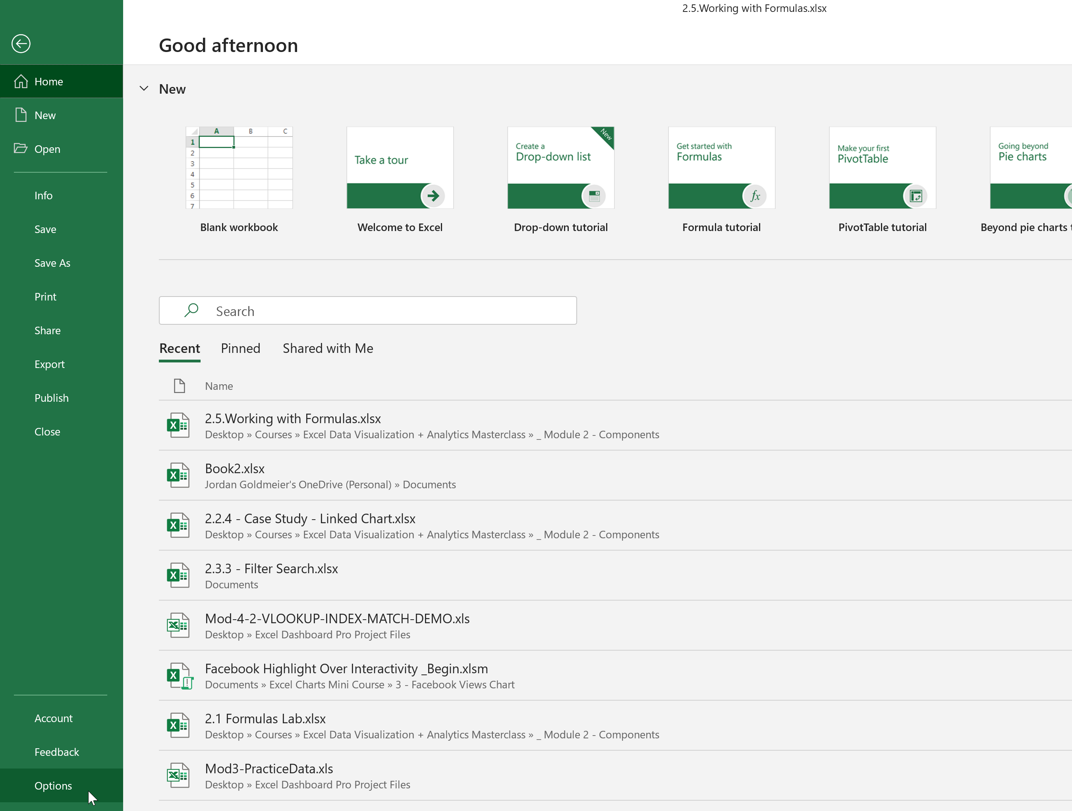
Click Options in the lower left

Slide 4
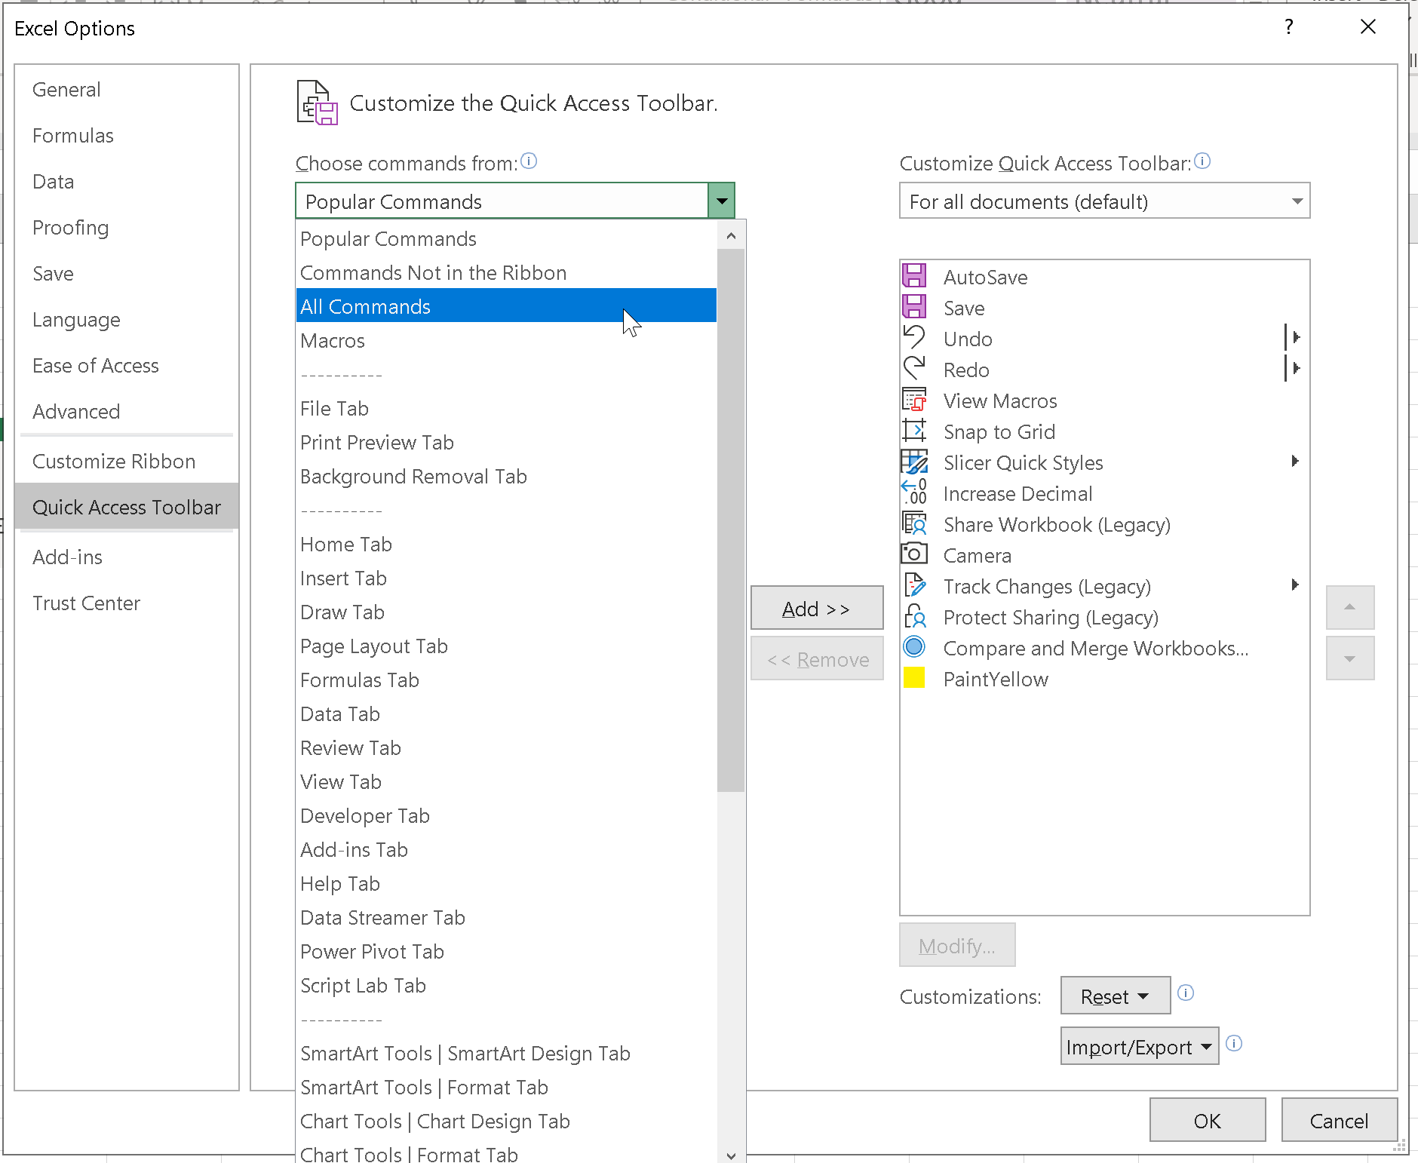
Click Quick Access Toolbar > All Commands (from the Choose Commands from dropdown)

Slide 5
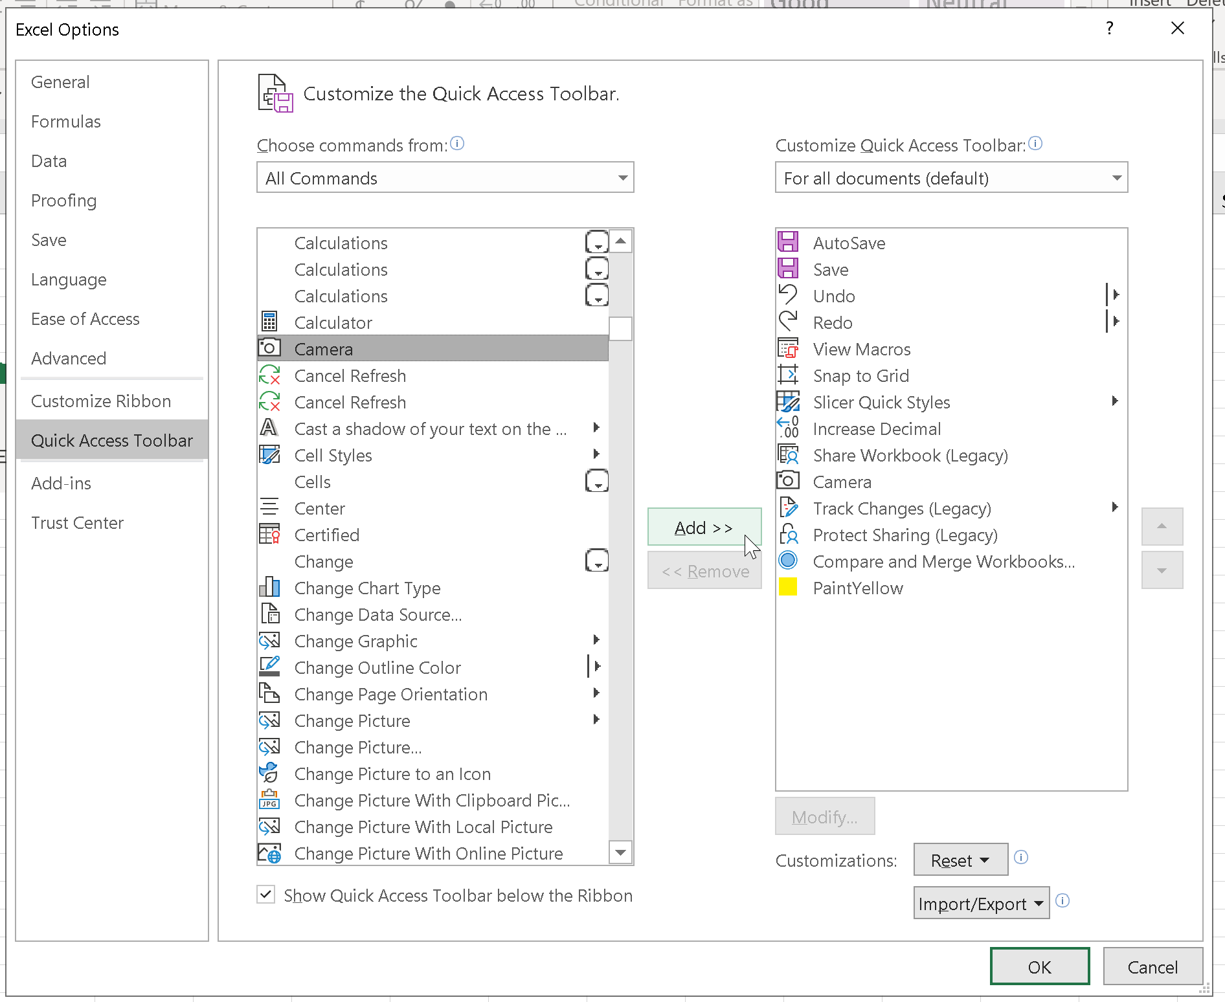
Find Camera. Click Add >> then click OK

